Slide 1
Java Language Basics
Lecturer：shenxueping
shenxueping@buaa.edu.cn

Slide 2
Java Program Structure

Slide 3
Java Program Structure(1)
package statement：0 or 1 ，in the beginning of the whole file
import：0 or more，in the beginning of the all classes, import standard class and existed classes
public classDefinition： 0 or1 ，the file’s name must be same as this class
nameclassDefinition： 0 or more ，the number of the classes is not limited
interfaceDefinition： 0 or more ，the number of the interfaces is not limited

Slide 4
Java Program Structure(2)
Example：
package project.gui.view;
import java.util.Calendar;
import java.awt.*;
import java awt.event.*;
import mywork.form;
public class ButtonExample{…}
class A{…}
class B{…} ……
interface ButtonInterface{…} ……

Slide 5
Simple Java OOP Programs
Initially each of our Java programs will consist of two classes: a program class and a runner class.
Program class: an object of this class defines what our program should do.
Runner class: tells the Java interpreter how to run our program.

Slide 6
public class Student{
public String name;
public char sex;
public String birthday;
private int compScore,engScore;
public Student(String str1,char ch,String str2){
name=str1;
sex=ch;
birthday=str2;
}
public void setCompScore(int data){
compScore=data;
}
public int getCompScore(){
return compScore;
}

Slide 7
public void setEngScore(int data)
{ engScore=data; }
public int getEngScore()
{ return engScore; }
public double getAverScore()
{ return(compScore+engScore)/2.0; }
public int getMaxScore()
{ int max;
if(compScore>engScore)
max=compScore;
else
max=engScore;
return max;}
public String toString(){
return "姓名"+name+";性别"+sex+";出生年月；"+birthday;
}

Slide 8
import java.awt.*;
public class TestStudent{
public static void main(String args[]){
Student stu1=new Student("Mary",'M',"1990.8.8");
System.out.println(stu1.toString());
stu1.birthday="1990.7.9";
System.out.println(stu1.toString());
stu1.setCompScore(98);
stu1.setEngScore(82);
System.out.println("计算机成绩："+stu1.getCompScore());
System.out.println("英语成绩："+stu1.getEngScore());
System.out.println("平均成绩："+stu1.getAverScore());
System.out.println("单科最高分："+stu1.getMaxScore());
}
}

Slide 9
A simple class declaration
public class
{
}
Choose a name
ClassName
Data field declarations
(constants and variables)
Constructor declarations
Method declarations
Stored in a file called ClassName.java

Slide 10
Runner class declaration
public class
{
public static void main(String[] args)
{
}
}
ClassNameRunner
Statements to construct a program
object and ask it to perform
computations
Stored in a file called ClassNameRunner.java

Slide 11
Circle calculator pseudo-code
program constructs a CircleCalculator object called circle
program asks circle to read value for its radius
program asks circle to calculate its area and circumference
program asks circle to display its radius, area and circumference
Example：Project：circle or circle2

Slide 12
CircleCalculatorRunner class
public class CircleCalculatorRunner
{
public static void main(String[] args)
{
CircleCalculator circle =
new CircleCalculator();
circle.readInput();
circle.doCalculations();
circle.displayResults();
}
}
construct object
send messages to
the circle object

Slide 13
Constructing an object
new CircleCalculator()
causes these statements to be executed
public CircleCalculator()
{
}
Statements

Slide 14
CircleCalculator class
data field
declarations
public class CircleCalculator
{
private double radius;
private double area;
private double circumference;
public CircleCalculator() {...}
public void readInput() {...}
public void doCalculations() {...}
public void displayResults() {...}
}
fill in method
details
Notes:
circumference [səˈkʌmfərəns]n. 周围; 圆周
Radius:半径

Slide 15
CircleCalculator constructor
public CircleCalculator()
{
radius = 0.0;
area = 0.0;
circumference = 0.0;
}
constructor
prototype
later we will see
that constructors
can have arguments
Here we just assign values of zero for each
data field. The actual radius will be obtained
using the readInput method and the area and
circumference will be calculated using the
doCalculations method.

Slide 16
readInput method
method prototype
public void readInput()
{
KeyboardReader input = new KeyboardReader(); System.out.println("Enter radius");
radius = input.readDouble();
}
Note: radius is a data field and has already been declared in the data field declaration part of the class.
A common error is to write
double radius = input.readDouble();
which would declare a local variable inside this method.

Slide 17
doCalculations method
method prototype
public void doCalculations()
{
area = Math.PI * radius * radius;
circumference = 2.0 * Math.PI * radius;
}
these are data field
variables and they
are not declared here

Slide 18
displayResults method
public void displayResults()
{
System.out.println("Radius: " + radius);
System.out.println("Area: " + area);
System.out.println("Circumference: "
+ circumference);
}
method prototype

Slide 19
Objects and Messages (1)
object to
receive
message
The dot separates
object name
from message name
radius = input.readDouble();
Method that sends
message to object
Assign result
to a double
variable

Slide 20
Objects and Messages (2)
System.out.println (area)
An object that knows
how to print data
The data that
should be printed
Send the println
message to this object

Slide 21
Data field and local variables
Data field variables
  radius, area, and circumference are data field variables. They are accessible anywhere in the class.
Local variables
  declared inside a constructor or method and are only available inside the constructor or method.
  input is the only example in CircleCalculator

Slide 22
Constructor declaration
Here is a general template for a constructor declaration
modifiers
ClassName
(
formalArgumentList
)
{
local declarations and other statements
}

Slide 23
Method declaration
Here is a general template for a method declaration
modifiers
returnType
methodName
(
formalArgumentList
)
{
local declarations and other statements
}

Slide 24
Compiling and running (1)
The circle calculator program consists of three files:
  KeyboardReader.java
  CircleCalculatorRunner.java
  CircleCalculator.java
Each of these classes must be compiled first to obtain the class files (bytecode)

Slide 25
Compiling and running (2)
The KeyboardReader class is a custom class that is not part of standard java so you need to find the file KeyboardReader.java and copy it to the directory containing your classes.

Slide 26
Compiling and running (3)
The KeyboardReader class needs to be compiled only once using the command
  javac KeyboardReader.java
This gives the file KeyboardReader.class containng the bytecodes. Now if your program needs to get console input simply put this class file in your program directory.

Slide 27
Compiling and running (4)
Now compile the two classes using
javac CircleCalculator.java
javac CircleCalculatorRunner.java
  This produces the class files called CircleCalculator.class
  CircleCalculatorRunner.class
  containing the bytecode for the Java virtual machine
Now ask the Java interpreter to run the program
  java CircleCalculatorRunner

Slide 28
Output from runner class
The Java interpreter produces the output
Enter radius
3
Radius: 3.0
Area: 28.274333882308138
Circumference: 18.84955592153876

Slide 29
Identifiers, Keywords, and Types

Slide 30
Objectives
Use comments in a source program
Distinguish between valid and invalid identifiers
Recognize Java technology keywords
List the eight primitive types
Define literal values for numeric and textual types
Define the terms primitive variable and reference variable

Slide 31
Objectives
Declare variables of class type
Construct an object using new
Describe default initialization
Describe the significance of a reference variable
State the consequences of assigning variables of class type
Notes:
consequence [ˈkɔnsikwəns]n. 结果, 后果Nobody can tell what the consequences may be.没有人能说出可能的后果。 重要(性), 重大This matter is of great consequence to all of us.对于我们来说这件事非常重要。

Slide 32
Relevance
Do you know the primitive Java types?
Can you describe the difference between variables holding primitive values as compared with object references?

Slide 33
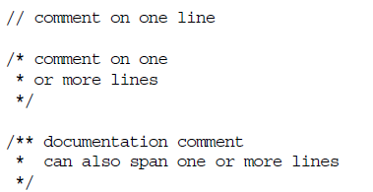
Comments
The three permissible styles of comment in a Java technology program are:

Slide 34


Semicolons, Blocks, and White Space
A statement is one or more lines of code terminated by a semicolon (;):
A block is a collection of statements bound by opening and closing braces:

Slide 35
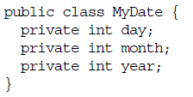
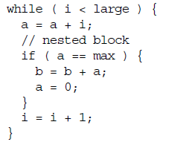
Semicolons, Blocks, and White Space
A class definition uses a special block:
You can nest block statements.

Slide 36
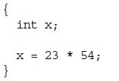
Semicolons, Blocks, and White Space
Any amount of white space is permitted in a Java program.For example:
{int x;x=23*54;}
is equivalent to:

Slide 37
Java Identifiers

Slide 38
Identifiers
Identifiers are simple names Used as names of classes, methods and variables within a programming language
In Java, identifiers can be any combination of letters, numbers, '_' and '$‘
However, identifiers cannot begin with a number and #
Identifiers in Java are also case-sensitive
Identifiers cannot be keyword.

Slide 39
Identifiers
Remarks
  Unusual but legal characters: π
  Case-sensitive: VALUE≠Value
  Length limitation : arbitrary(very long)
Suggestion on lower- and upper-case letters
  Public methods/instance variables: getTimeOfDay
  Private variables: lowercase and _j, next_val
  Constant Variables: FRIDAY, GREEN

Slide 40
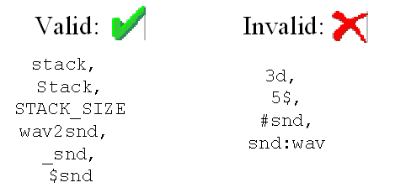

Slide 41
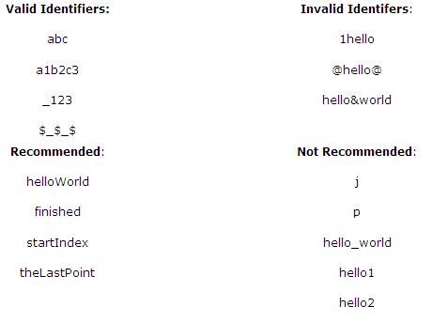

Slide 42
Keywords

Slide 43
Keywords
These words are reserved you cannot use any of these words as names in your programs. True, false, and null are not keywords but they are reserved words, so you cannot use them as names in your programs either.

Slide 44
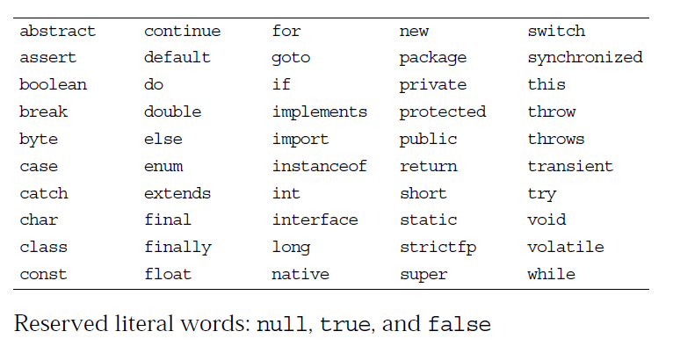
Keywords

Slide 45
Java Data Type and
Literal /Constants

Slide 46
public class App1{
public static void main(String args[]){
//定义整形变量a和双精度浮点变量b、c
int a=126;
double b=0.2;
double c=1.6;
//创建字符串对象
String str1="Hello World"; //////////////////
String str=new String("字符串不是基本数据类型");
//输出各个变量
System.out.println("a="+a);
System.out.println("b+c="+(b+c)); System.out.println("b+c="+b+c); System.out.println(str);
System.out.println(str1);
}
}
a=126
b+c=1.8
b+c=0.21.6
字符串不是基本数据类型
Hello World

Slide 47
Java Data Type
Strong Typing: security and robustness
Type Classification
  Simple(primitive) types: byte, short, int, long, float, double, boolean , char
  Structured(Refrence)types: Array,Class,Interface

Slide 48
整数类型：byte，short，int，long
Data Type
数值类型
浮点数类型：float，double
基本数据类型
primitive data types
字符类型：char
数据类型
布尔类型：boolean
类类型
复合数据类型
Complex data types
数组
接口类型：interface
Reference types

Slide 49
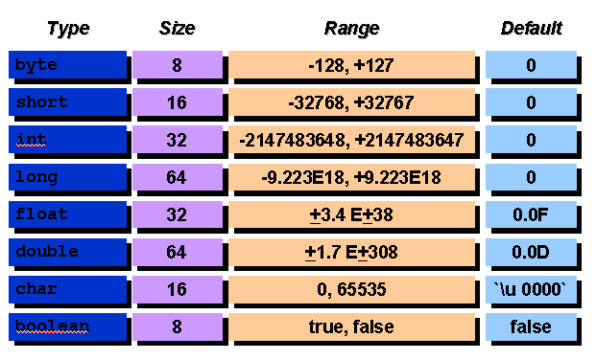
primitive data types
Notes:
Java 中所有都是有符号的

Slide 50
Unicode
Coding: international
ASCII(7)⊆
ISO-Latin-1(8) ⊆
Unicode(16)
Unicode Letters and Digits
<Unicode digit>::=
\u0030- \u0039 0-9 ISO-LATIN-1digits
\u0660- \u0669 Arabic-Indic digits ……
<Unicode letter>::=
\u0024 $ dollar sign (for historical reasons)
\u0041- \u005a A-Z Latin capital letters
\u0061－\u007a a-z Latin small letters ……

Slide 51
Literal /Constants(1)
Integer Constants
  Int Values(32bits): Decimal , Hexadecimal, Octal
  Long Int Values(64b): Attached by L or l
Float Constants
  Double(64b): Default
  Float: Attached by F or f
Boolean Constants
  true, false
  true≠1, false≠0
Notes:
decimal [ˈdesiməl]adj. 十进位的, 小数的He knows the decimal rules.他懂得十进制的用法。
literal [ˈlitərəl]adj. 照字面的, 原义的The literal meaning of the word “cat” is an animal.“猫”一词的本义是动物。 逐字的He made a literal interpretation.他逐字解释。

Slide 52
Literal /Constants(2)
Char
String
Identified/Named Constants
  Static final variables as constants
  Example 1: static final float π = 3.1416;
  Example 2: integrate several named constants
  class Suit {
    final static int CLUBS = 1;
    final static int DIAMONDS = 2;
    final static int HEARTS = 3;
    final static int SPADES = 4;
  }
Notes:
Diamond：方块
Heart：红桃
Spade:
Club:

Slide 53
Logical – boolean
The boolean primitive has the following characteristics:
  The boolean data type has two literals, true and false.
  For example, the statement:
  boolean truth = true;
  declares the variable truth as boolean type and assigns it a value of true.

Slide 54
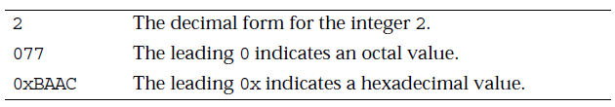
Integral – byte, short, int, and long
The integral primitives have the following characteristics:
  Integral primates use three forms: Decimal, octal, or hexadecimal.
  Literals have a default type of int.
  Literals with the suffix L or l are of type long.

Slide 55
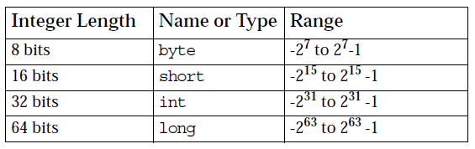
Integral – byte, short, int, and long
Integral data types have the following ranges:

Slide 56
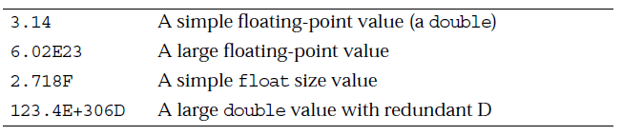
Floating Point – float and double
The floating point primitives have the following characteristics:
  Floating-point literal includes either a decimal point or one of the following:
    E or e (add exponential value)
    F or f (float)
    D or d (double)

Slide 57
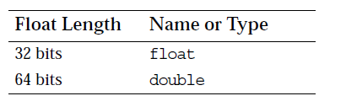
Floating Point – float and double
Literals have a default type of double.
Floating-point data types have the following sizes:

Slide 58
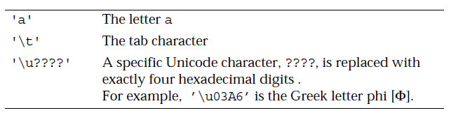
Textual – char
The textual char primitive has the following characteristics:
  Represents a 16-bit Unicode character that can be converted to integer and processed by integer operators
  Must have its literal enclosed in single quotes (’ ’)
  Uses the following notations:

Slide 59
Textual – String
The textual String type has the following characteristics:
  Is not a primitive data type; it is a class
  Only in one line, otherwise use +operation
  Has its literal enclosed in double quotes (" ")
  "The quick brown fox jumps over the lazy dog.“
  Can be used as follows:
  String greeting = "Good Morning !! \n";
  String errorMessage = "Record Not Found !";
  String str=new String(“Hello”);

Slide 60
String Concatenation With +
The + operator works as follows:
  Performs String concatenation
  Produces a new String:
    String salutation = "Dr.";
    String name = "Pete" + " " + "Seymour";
    String title = salutation + " " + name;
One argument must be a String object.
Non-strings are converted to String objects automatically.

Slide 61
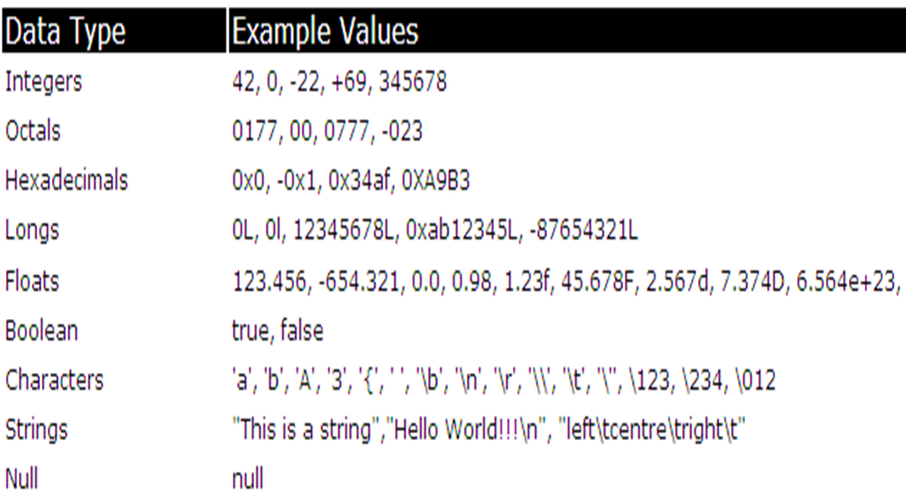
Literals-Data Type Values

Slide 62
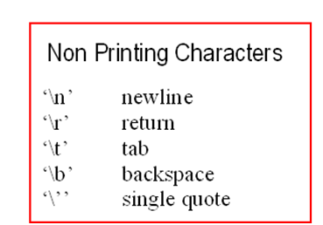

Slide 63
Variables, Declarations, and
Assignments

Slide 64
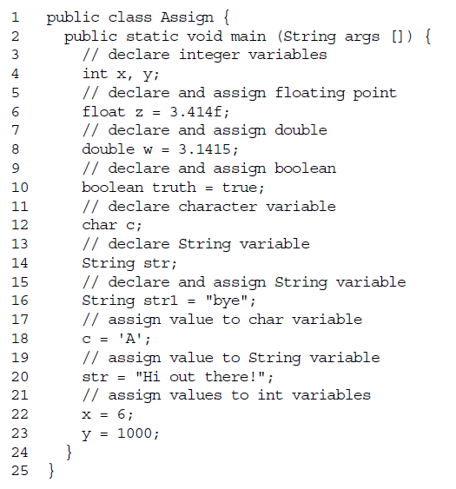

Slide 65
public class VarDemo {
public static void main(String[] args) {
byte b=0x55; boolean B=true;
short s=0x55ff; int i=1000000;
long l=0xffffL; char c='c';
float f=0.23F; double d=0.7E-3;
String S="This is a string";
System.out.println("字节型变量 b = "+b);
System.out.println("短整型变量 s = "+s);
System.out.println("整型变量 i = "+i);
System.out.println("长整型变量 l = "+l);
System.out.println("字符型变量 c = "+c);
System.out.println("浮点型变量 f = "+f);
System.out.println("双精度变量 d = "+d);
System.out.println("布尔型变量 B = "+B);
System.out.println("字符串对象 S = "+S);
}}

Slide 66
字节型变量 b = 85
短整型变量 s = 22015
整型变量 i = 1000000
长整型变量 l = 65535
字符型变量 c = c
浮点型变量 f = 0.23
双精度变量 d = 7.0E-4
布尔型变量 B = true
字符串对象 S = This is a string

Slide 67
Type Conversion and Casting

Slide 68
Type Conversion and Casting
Java’s Automatic Conversions
  When one type of data is assigned to another type of variable, an automatic type conversion will take place if the following two conditions are met:
    The two types are compatible.
    The destination type is larger than the source type.
Casting Incompatible Types
  Narrowing conversion: explicitly making the value narrower so that it will fit into the target type.

Slide 69
Type conversion(1)
Automatic conversion : windening
(1) “lifting from small to large” T2→T1
(2) Basic values: scope of ranges
byte→int, char→int, long→float, float→double
Notes
  Byte and short values are lifted as int values before calculation. So byte and short types are used for storage, not for calculation
  If an expression contains byte, short, int, and long constants or variables, the type will be long
  If an expression contains float and double constants or variables, the type will be double

Slide 70
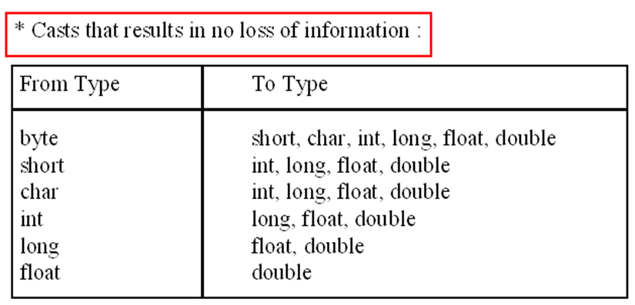
Automatic conversion

Slide 71
Type conversion(2)
Coercion of Type : narrowing
  (1) “Compressing from large to small”
  (2) Syntax: (type)value
  (3) Example:
    double→long, float→int, double→float
  (4) instanceof:
Notes:
Coercion：强制
coercion [kəuˈə:ʃən]n. 强迫; 胁迫

Slide 72
Type conversion(3)
Examples
(1) byte a=40, b=50, c=100; int d=a*b/c;
a*b is lifted as int before divided by c
(2) byte b=50; b=b*2;
A compiling error occurs because b*2 is lifted as int.
Correction: b=b*2; → b=(byte)b*2
(3) byte b=42; char c=’a’; short s=1024;
int i=50000; float f=5.67f; double d=.1234
(f*b)+(i/c)-(d*s) float+int-double → double
(4) short s=-134; byte b=(byte)s; // b=122
(5) int i=’\uffff’; //65535 ; short s =(short)’\uffff’; //-1

Slide 73
Type conversion(4)
Dessert: D
Cake: C
Scone: S
(6) C=new Cake();
D=C;
if D instanceof Cake {
C=(Cake) D; …
}
? S=(Scone) D;
Error!
Notes:
Scone：烤饼; 烤小圆面包
重新修改

Slide 74
//12.414是双精度量,不能赋给单精度变量z1。该语句错误
例:
long bigval = 6;
int smallval = 99L;
float z = 12.414F;
float z1 = 12.414;
long bigVal=12L;
int smallVal=(int)(bigVal);
//12.414F是浮点量,该语句正确
//99L是长整型量, smallval是int型量,赋值不相容，该语句错误
//6是整型量，所以该语句正确

Slide 75
Java Reference Types

Slide 76
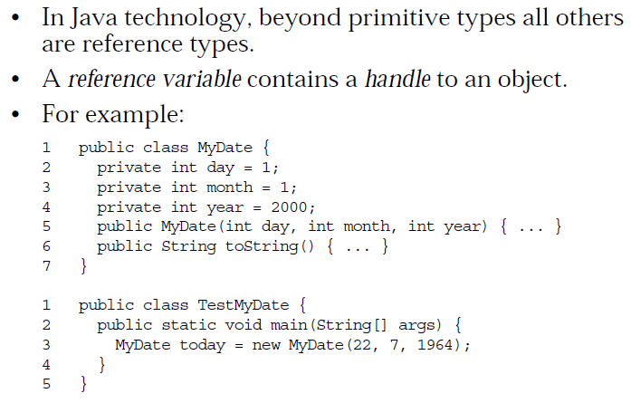
Java Reference Types
Notes:
handle [ˈhændl]n. 手柄, 把手

Slide 77
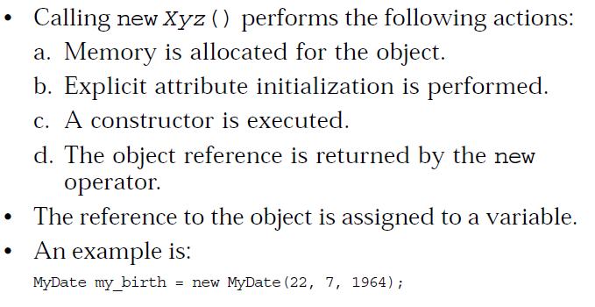
Constructing and Initializing Objects

Slide 78
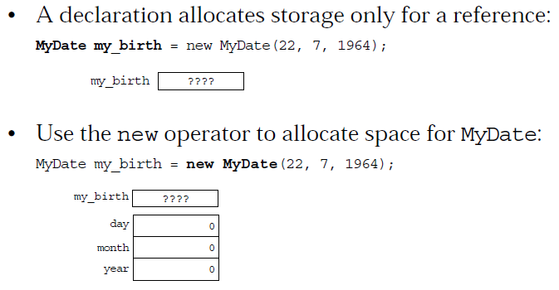
Memory Allocation and Layout

Slide 79
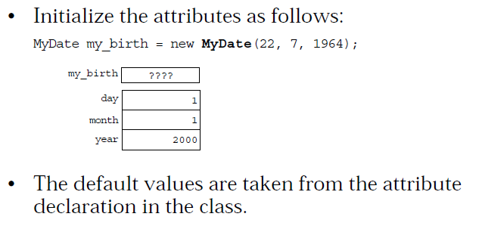
Explicit Attribute Initialization

Slide 80
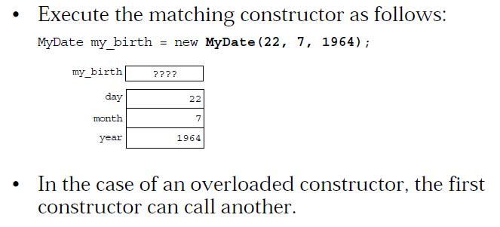
Executing the Constructor

Slide 81
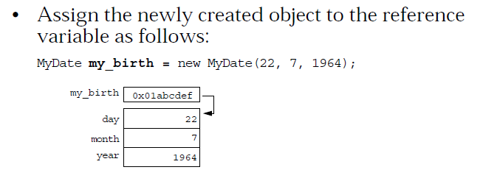
Assigning a Variable

Slide 82
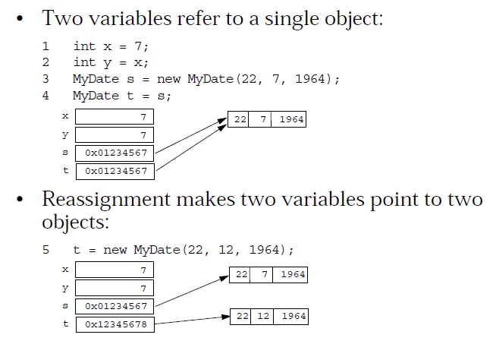
Assigning References

Slide 83
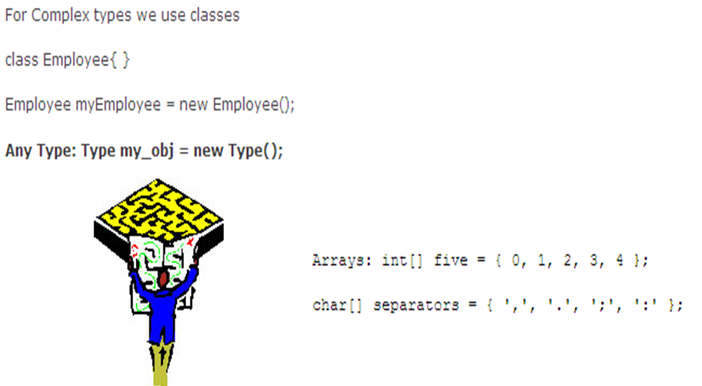
Complex Types

Slide 84
Calss wrapper for primitive data types(cont.)
Boolean for boolean
Byte for byte
Character for char
Short for short
Integer for int
Long for long
Float for float
Double for double
八大原始类别，Primitive Data Types
Class Wrappers

Slide 85
Java Operators

Slide 86
Operators
Arithmetic Operators
Relational and Conditional Operators
Shift and Logical Operators
Assignment Operators
Other Operators

Slide 87
Operators
Operator types:
  Unary operators : require one operand, for example, ++.
  Binary operators : require two operands, for example, =.
  Ternary operators require three operands. The only one in Java is ?:
    Which is a short-hand if-else statement.
  Prefix : operator op
  Postfix : op operator
  Infix : op1 operator op2 expr ? op1 : op2

Slide 88
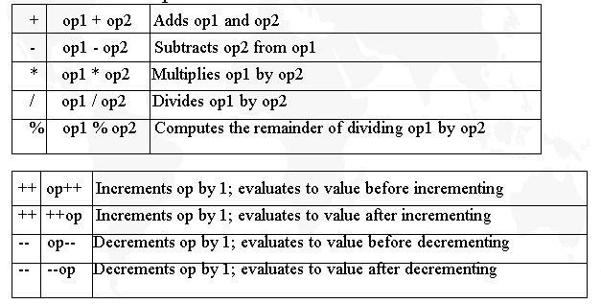
Arithmetic Operators
Arithmetic Operators

Slide 89
  int i=10;
  int j=10;
  int x=i++;
  int y=++j;
  int z=i;
result：x=10;
y=11;
z=11;

Slide 90
public class TestArithmetic
{
public static void main(String[] args)
{
int n=1859,m;
int a,b,c,d;
d=n/1000;
c=n/100%10;
b=n/10%10;
a=n%10;
m=a*1000+b*100+c*10+d;
System.out.println("原来的四位数：n="+n);
System.out.println(“每位逆序后的四位数：
m="+m); }
}
原来的四位数：n=1859
每位逆序后的四位数：m=9581

Slide 91
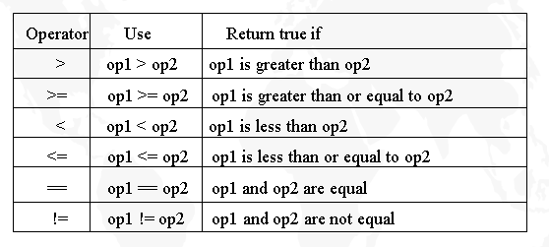
Relational Operators

Slide 92
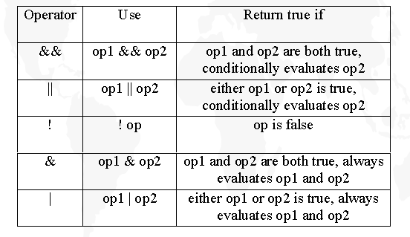
Conditional Operators

Slide 93
op1 | op2 | op1&op2 | op1|op2 | !op1
false | false | false | false | true
false | true | false | true | true
true | false | false | true | false
true | true | true | true | false
example：boolean a=true;
boolean b=false;
boolean flag=true;
if(b&&a)
flag=true;
else
flag=false;
example：boolean a=true;
boolean b=false;
boolean flag=true;
if(a||b)
flag=true;
else
flag=false;

Slide 94
public class Test{
public static void main(String[] args)
{
int a=25, b=3, e=3, f=0;
boolean d=a<b;
System.out.println("a=25,b=3,e=3,f=0");
System.out.println("a<b = "+d);
if (e!=0 && a/e>5)
System.out.println("a/e = "+a/e);
if (f!=0 && a/f>5)
System.out.println("a/f = "+a/f);
else
System.out.println("f = "+f);
}
}
a=25,b=3,e=3,f=0
a<b = false
a/e = 8
f = 0

Slide 95
public class FindMinMax{
public static void main(String []args)
{
double temp, max, min;
double d1=1,d2=-9.9,d3=96.9;
temp=d1>d2?d1:d2;
temp=temp>d3?temp:d3;
max=temp;
temp=d1<d2?d1:d2;
temp=temp<d3?temp:d3;
min=temp;
System.out.println("max="+max);
System.out.println("min="+min);
}
}
max=96.9
min=-9.9

Slide 96
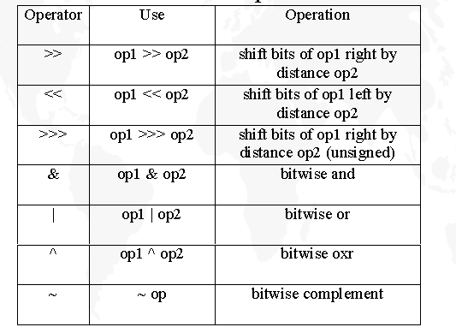
Bitwise Operators

Slide 97
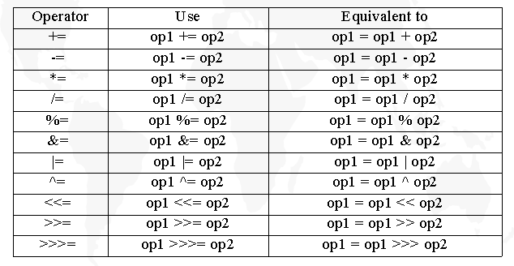
Assignment Operators

Slide 98
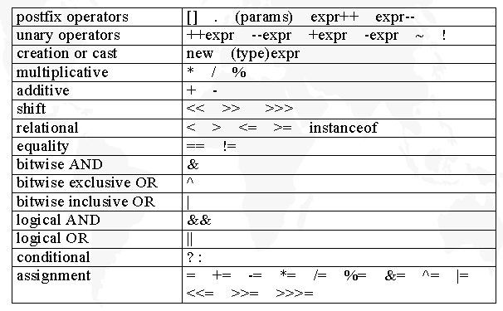
Operator Precedence

Slide 99
Java Expressions

Slide 100
Expressions
Definition: An expression is a series of variables, operators, and method calls that evaluates to a single value.
  The data type of the result of an expression depends on the elements used in the expression.
  A method call expression evaluates to the return value of the method
Notes:
evaluate [iˈvæljueit]vt. 评价, 估计, 估价

Slide 101
Java Delimiters

Slide 102
Delimiters
() Method definition and call, expr, unary cast(type)
{} Array initialization, code block
[] Array subscript(definition and indexing)
; Statement separation
, Identifier separation, and FOR statement
. Member selection( Package & class, object & variable or method)
Notes:
delimiter [di:ˈlimitə]n. 定界符,分隔符

Slide 103
Variables and Scope

Slide 104
Variable
Syntax modifier* type id [=value]
  type: byte|short|int|long|char|float|double|boolean|class ID|interface ID
  value: constants or expressions of the type
  Initialization: Assignment (id=value ), Default (0,null)
  Modifier: static | final | public | protected | private |abstract |native | synchronized

Slide 105
Variables and Scope
instance variables
  how to initialize instance variables?
    constructor
local variables
  Variables that are defined inside a method and are called local, automatic, temporary, or stack variables
  Variables that are created when the method is executed are destroyed when the method is exited

Slide 106
Variables and Scope
Variable initialization comprises the following:
  Local variables require explicit initialization.
  Instance variables are initialized automatically.

Slide 107
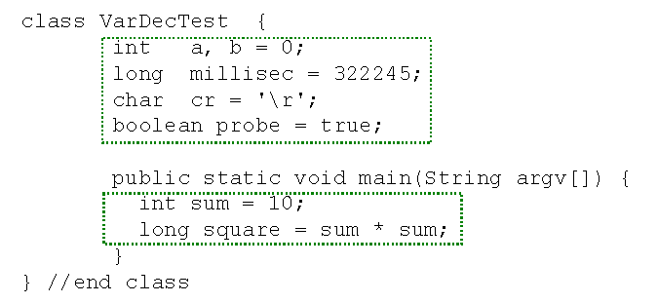
Variable Declaration

Slide 108
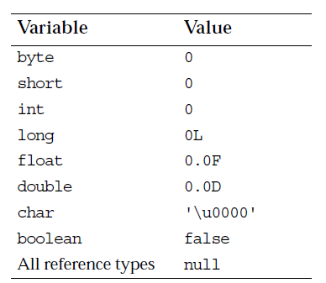
Variable Initialization

Slide 109
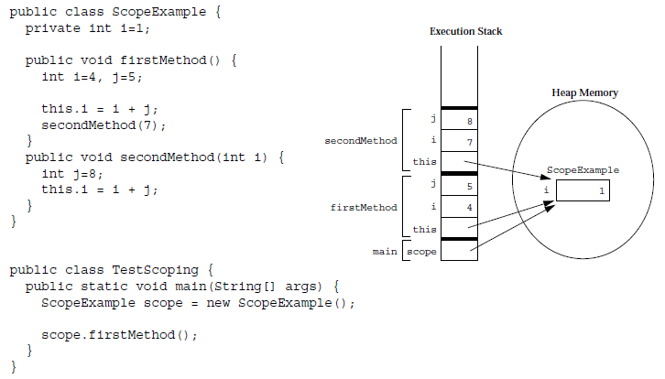
Variable Scope Example

Slide 110
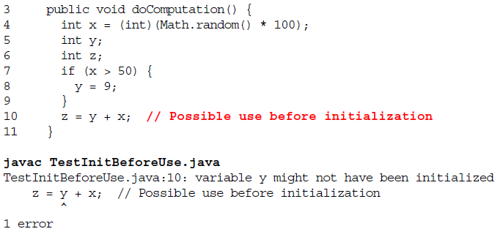
Initialization Before Use Principle
The compiler will verify that local variables have been initialized before used.

Slide 111
Variable
Scoping: valid or applicable area of the variable
(Nested) compound {} and FOR statements
Correct Example:
... { int bar1=3; {int bar2=5} }…
Wrong Example:
... { int bar1=3; {int bar1=5} }…
Notes:
compound [ˈkɔmpaund]n. 复合物, 化合物

Slide 112
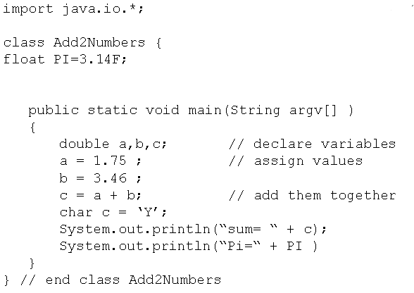
A Simple Example (with 1 error!)

